Slide 1
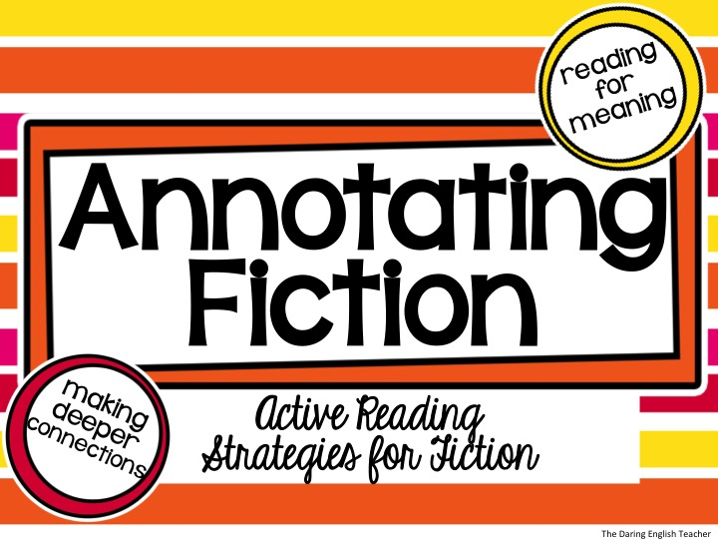

Slide 2
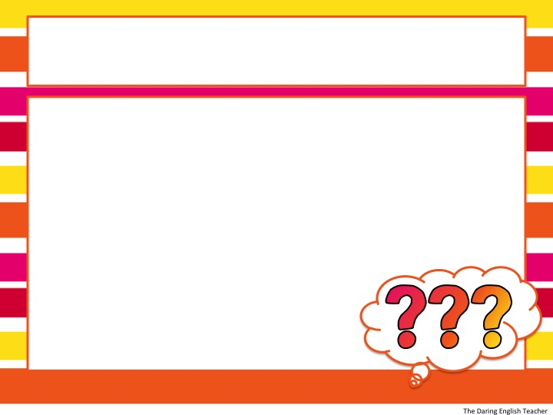
Raise your hand if…
you have ever read an entire paragraph, passage, or page only to realize that you have absolutely no clue what you just read.

Slide 3
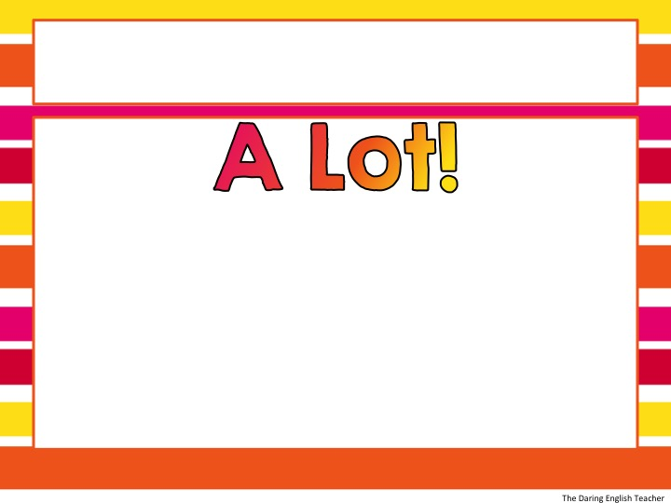
It happens…
STOP WASTING TIME WITH MINDLESS READING!
Annotating a text will help you not only remember what you read, but understand and connect with the text.

Slide 4
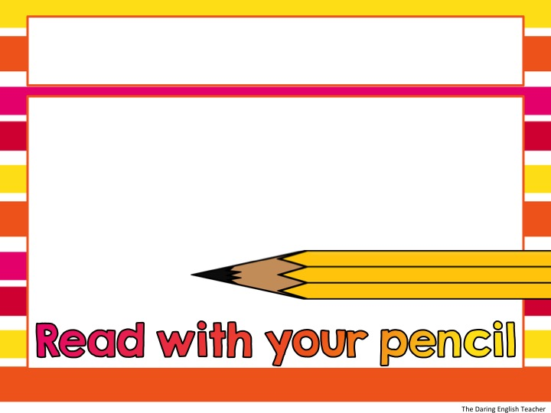
What is Annotating?
Annotation is the ACT of making a note in ANY form while reading

Slide 5
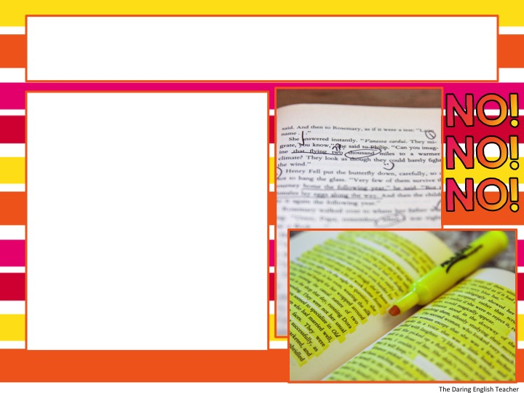
Annotation is NOT…
Highlighting without a purpose
Underlining or highlighting the majority of the text
Drawing symbols without writing notes

Slide 6
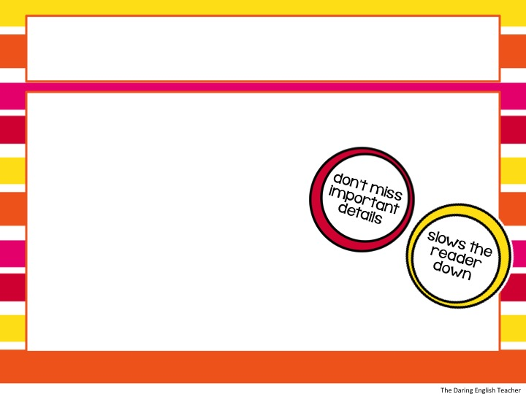
Why Do We Annotate?
The majority of reading is just skimming, this is NOT helpful when reading for understanding.
Annotating a Text:
slows the reader down
promotes active reading
improves reading and writing
allows the reader to make deeper connections

Slide 7
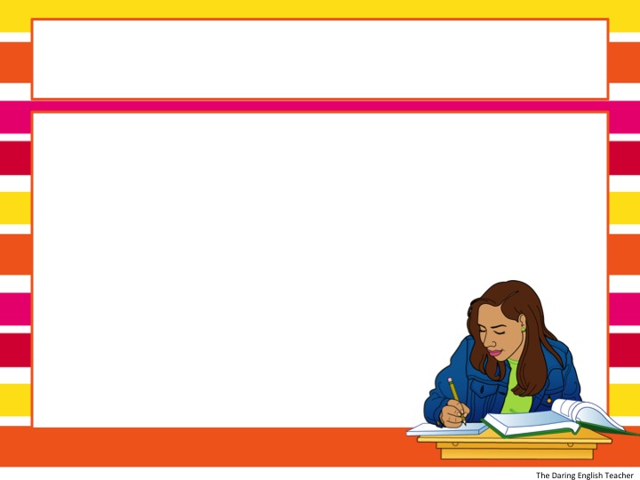
What Will I Need?
Annotation tools:
Pencil
Colored pens (optional)
Highlighter (optional)
Post-it notes (optional)
Annotation Guide
Your own copy of the text!

Slide 8
Annotation Guide
Symbol | Guide
underline | Characters and words/ phrases the author uses for characterization *Notice: main characters will change throughout the story
circle | The setting and descriptive phrases that reveal information about the setting
number | Number significant events in the plot
Box | Place a box around vocabulary/unknown words
? | Write a question mark next to ideas, events, or references you don’t understand/know
( ) | Place parenthesis around key information that reveals information about the theme –values, beliefs, morals, etc.
 | Place a star next to the climax (highest emotional moment) of the story
WRITE | Predictions as you read
WRITE | Comment on the author’s style (tone, diction, pacing)

Slide 9
Annotation Guide
Symbol | Guide
underline | Write down connections you make and additional information about the characters in the margin
circle | Write down connections you make and additional information about the setting in the margin
number | Write a brief summary in your own words in the margin
Box | Write the definitions of the words in the margin
? | As the questions become more clear, write the answers in the margin
( ) | Briefly write how this information contributes to the theme of the story
 | Make a prediction about how you think the conflicts will be resolved
WRITE | As you read, make predictions about what will happen; write these predictions in the margin
WRITE | In the margin, specific information about the author’s style

Slide 10
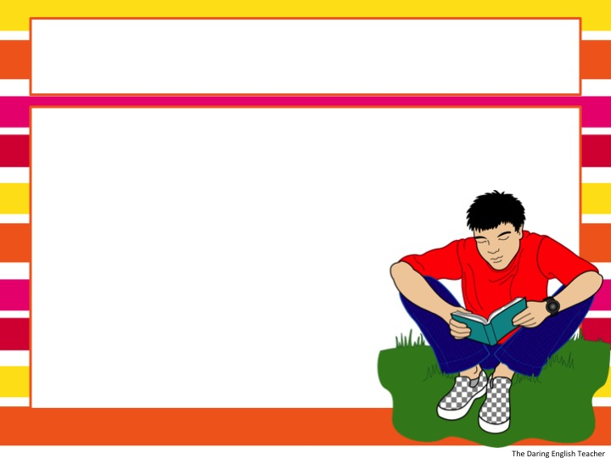
Steps to Annotate Text
1. Preview the text.
- Is the text a novel, short story, or other?
- Read the title/Look at illustrations
- Who is the author?
- What is the genre?
- What do you know about
similar texts?
*Write predictions based on your
preview of the text!

Slide 11

Steps to Annotate Text
2. Begin reading the text. Focus on just a few paragraphs at a time.

Slide 12
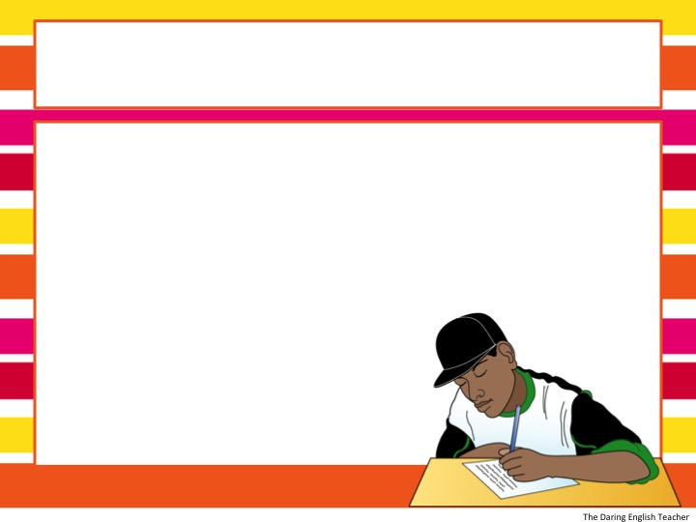
Steps to Annotate Text
3. As you read, use the annotation guide to help you make notes on the text. Use your own words as much as possible. Make sure to add text to symbols for extra clarification.

Slide 13
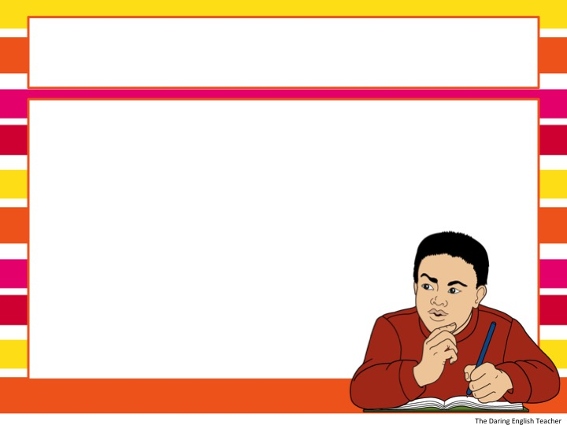
Steps to Annotate Text
4. Occasionally as you read, check and see if your annotations make sense. It is okay if you have to pause and read some paragraphs again for more clarity.

Slide 14

Steps to Annotate Text
5. Repeat steps 2-4 as you read the entire text. Remember to pause occasionally to review your notes.

Slide 15
Practice
The Lion and the Mouse
By: Aesop
Use the symbols from the previous slide to annotate one of Aesop’s fables.
Once when a Lion was asleep a little Mouse began running up
and down upon him; this soon wakened the Lion, who placed his huge paw upon him, and opened his big jaws to swallow him. "Pardon, O King," cried the little Mouse: "forgive me this time, I shall never forget it: who knows but what I may be able to do you a turn some of these days?" The Lion was so tickled at the idea of the Mouse being able to help him, that he lifted up his paw and let
him go. Some time after the Lion was caught in a trap, and the
hunters who desired to carry him alive to the King, tied him to a
tree while they went in search of a wagon to carry him on. Just
then the little Mouse happened to pass by, and seeing the sad
plight in which the Lion was, went up to him and soon gnawed away the ropes that bound the King of the Beasts. "Was I not right?” said the little Mouse.

Slide 16
Practice
The Lion and the Mouse
By: Aesop
Step 1:
Preview the Text
What is the genre?
Who is the author?
What do we know about this text?
Once when a Lion was asleep a little Mouse began running up
and down upon him; this soon wakened the Lion, who placed his huge paw upon him, and opened his big jaws to swallow him. "Pardon, O King," cried the little Mouse: "forgive me this time, I shall never forget it: who knows but what I may be able to do you a turn some of these days?" The Lion was so tickled at the idea of the Mouse being able to help him, that he lifted up his paw and let
him go. Some time after the Lion was caught in a trap, and the
hunters who desired to carry him alive to the King, tied him to a
tree while they went in search of a wagon to carry him on. Just
then the little Mouse happened to pass by, and seeing the sad
plight in which the Lion was, went up to him and soon gnawed away the ropes that bound the King of the Beasts. "Was I not right?” said the little Mouse.

Slide 17
Practice
The Lion and the Mouse
By: Aesop
Step 2-3:
Read a brief portion of the text and annotate.
Once when a Lion was asleep a little Mouse began running up
and down upon him; this soon wakened the Lion, who placed his huge paw upon him, and opened his big jaws to swallow him.

Slide 18
Practice
The Lion and the Mouse
By: Aesop
Step 2-3:
Read a brief portion of the text and annotate.
Once when a Lion was asleep a little Mouse began running up
and down upon him; this soon wakened the Lion, who placed his huge paw upon him, and opened his big jaws to swallow him.
?
Q: Why would a little mouse run up and down a big lion?
A: The author uses this example to set the initial conflict between the mouse and lion.
1
Setting: The beginning of the fable takes place on a lion.
The lion is going to eat the mouse!
2
Huge paw and big jaws – these phrases help emphasize how big the lion is
Prediction: What do you think is going to happen to the mouse?

Slide 19
Practice
The Lion and the Mouse
By: Aesop
Step 4:
Review your annotations and notes to check for clarity.
Once when a Lion was asleep a little Mouse began running up
and down upon him; this soon wakened the Lion, who placed his huge paw upon him, and opened his big jaws to swallow him.
?
Q: Why would a little mouse run up and down a big lion?
A: The author uses this example to set the initial conflict between the mouse and lion.
1
Setting: The beginning of the fable takes place on a lion.
The lion is going to eat the mouse!
2
Huge paw and big jaws – these phrases help emphasize how big the lion is
Prediction: What do you think is going to happen to the mouse?

Slide 20
Practice
The Lion and the Mouse
By: Aesop
Step 5:
Repeat steps 2-4 as you annotate the rest of the text.
Once when a Lion was asleep a little Mouse began running up
and down upon him; this soon wakened the Lion, who placed his huge paw upon him, and opened his big jaws to swallow him.
"Pardon, O King," cried the little Mouse: "forgive me this time, I shall never forget it: who knows but what I may be able to do you a turn some of these days?"
?
Q: Why would a little mouse run up and down a big lion?
A: The author uses this example to set the initial conflict between the mouse and lion.
1
Setting: The beginning of the fable takes place on a lion.
The lion is going to eat the mouse!
2
Huge paw and big jaws – these phrases help emphasize how big the lion is
Prediction: What do you think is going to happen to the mouse?
Repetition of the word little emphasizes just how little the mouse is!!
The mouse asks the lion to let him go and in return promises to help him out one day.

Slide 21
The Lion and the Mouse
Once when a Lion was asleep a little Mouse began running up and down upon him; this soon wakened the Lion, who placed his huge paw upon him, and opened his big jaws to swallow him. "Pardon, O King," cried the little Mouse: "forgive me this time, I shall never forget it: who knows but what I may be able to do you a turn some of these days?" The Lion was so tickled at the idea of the Mouse being able to help him, that he lifted up his paw and let him go. Some time after the Lion was caught in a trap, and the
hunters who desired to carry him alive to the King, tied him to a tree while they went in search of a wagon to carry him on. Just then the little Mouse happened to pass by, and seeing the sad plight in which the Lion was, went up to him and soon gnawed away the ropes that bound the King of the Beasts. "Was I not right?” said the little Mouse.
Little friends may prove great friends.

